Slide 1
Rehashing
Hash Table may get full
  No more insertions possible
Hash table may get too full
  Insertions, deletions, search take longer time
Solution: Rehash
  Build another table that is twice as big and has a new hash function
  Move all elements from smaller table to bigger table

Slide 2
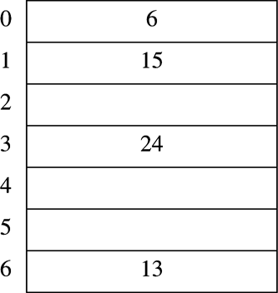
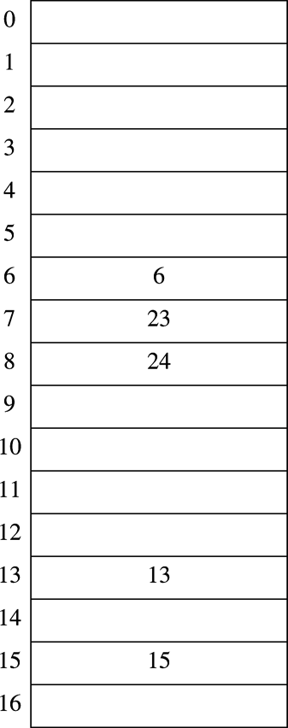
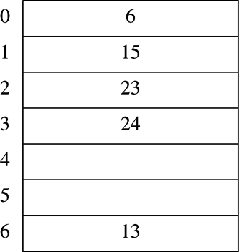
Rehashing Example
Input 13,15,6,24
h(x)=x mod 17
h(x)=x mod 7
After Rehashing
Original Hash Table
After Inserting 23

Slide 3
Rehashing for open addressing hash tables
typedef struct hashtbl *hashtable;
enum kindofentry {legitimate, empty, deleted};
struct hashentry
{
elementtype element;
enum kindofentry info;
};
typedef struct hashentry cell;
struct hashtbl
{
int tablesize;
cell *thecells;
};

Slide 4
Contd.
hashtable rehash(hashtable h)
{
int i,oldsize;
cell *oldcells;
oldcells=h->thecells;
oldsize=h->tablesize;
h=initializetable(2*oldsize);
for(i=0;i<oldsize;i++)
if(oldcells[i].info == legitimate)
insert(oldcells[i].element,h);
free(oldcells);
return h;
}

Slide 5
Extendible Hashing
When the data is bulky, there will be too many disk accesses.
To reduce the disk accesses, extendible hashing can be used.
Assume n records need to be placed in the place of m records in a disk block, it results in too many disk references while handling the collisions.

Slide 6
Example
  Maintain the information in the form of directory
  The root holds some key information
  The leaves are based on some specific features
  If we have k bits chosen in the header, then the number of entries at root will be 2^{k}
  Assume each data is of 8 bits. Let the set of numbers be 0000 0100, 0010 0000, 0000 1010, 0000 1011, 0101 0100, 0101 1000, 1010 0000, 1010 1000, 1111 1111
  We frame the root to have : 00,01,10,11 as the key fields

Slide 7
00
01
10
11
00000100
0010000000001010
00001011
11111111
01010100
01011000
10100000
10101000
Insert 0101 1100 and 0011 0011

Slide 8
Contd. Can’t insert 00110011
00
01
10
11
00000100
0010000000001010
00001011
11111111
01010100
01011000
01011100
10100000
10101000

Slide 9
Extendible hashing splits the directory itself. So consider 3 bits in the root.
000
001
010
011
100
101
110
111
00000100
00001010
00001011
00100000
00110011
01010100
01011000
01011100
10100000
10101000
11111111

